Slide 1

Mobile Application Development
Tony mainala

Slide 2
This is a person who has full understanding, vision of the big picture in app development, he has the look and feel in devices, servers, containers that are accessed to provide data, testing and debugging, reasoning and choosing solutions among many alternatives.
Android full stack developer

Slide 3
Prototyping and version control
This helps to enhance how an app looks, experiments on different ideas since a prototype is just a model of the solution that you’re looking for in most cases the prototype carries four crucial features: Accuracy, Display, efficiency and Flexibility these features also helps to visualize the apps interface and user experience.
The prototype contains all the essential parts of the App, like elements of UI, color, topography, content layout, buttons, icons, menus, forms, images, this helps the client to explore the app before its final out come and if there are any errors

Slide 4
Version Control
This is any kind of practice that keeps track and provides all control over changes to source code. Changes are mostly identified by numbers or letters known as version numbers example: version 1, version 2.
Commits can be thought of as timeline of a Git, they are created with git command to capture the state of a project at that point in time, mostly a commit is a snapshot at a particular point in time and every commit has date, author, commit message
Branche this act as a back bone where a code gets to be, when you want to make an update or add new features to an existing code all you need is to make a separate branch from the master branch then make new features, if they work fine and ok then you can merge the code back to the master branch

Slide 5
App concept
This app was developed for sharing content, comments, ideas by photographers, content creators and anyone interested.
Its core functions include Uploading content(pictures and videos), deleting, downloading, commenting, donating.

Slide 6
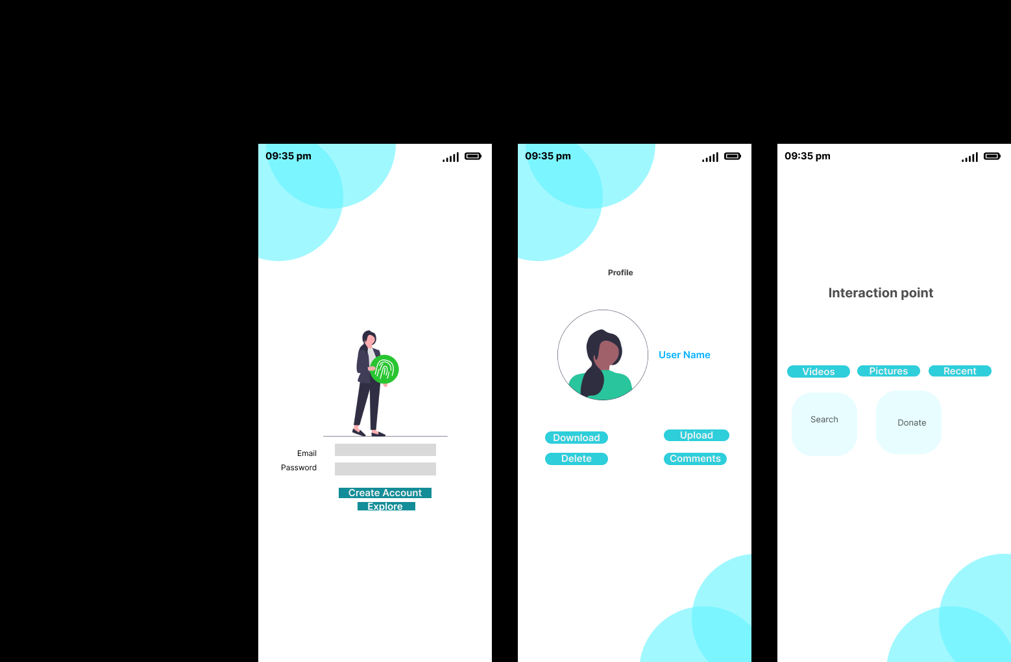
Figma design

Slide 7
Git version control
Learn about git.
Create a Git repository

